Slide 1
Gesellschaft für Biochemie und Molekularbiologie e.V.
founded 1947
with about 5000 members Germany's leading professional society for the life sciences

Slide 2
The GBM …
  Works non-profit
  offers contacts, scientific networks
  promotes research and teaching in biochemistry, molecular biology, biotechnology and molecular medicine
  supports young scientists and students
  organizes conferences and congresses
  nominates DFG referees
  communicates science to the public, is contact for media, politics and experts

Slide 3
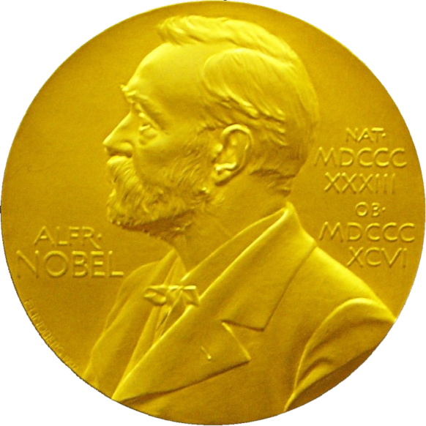
Nobel Laureate at the GBM
Günter Blobel
Adolf Butenandt
Emmanuelle Charpentier
Manfred Eigen
Fritz Lipmann
Feodor Lynen
Hartmut Michel
Christiane Nüsslein-Volhard
James E. Rothmann
Randy Schekman
Otto Warburg
Kurt Wüthrich
Harald zur Hausen

Slide 4
Young Member in the GBM
Low membership fee (25,- €/a)
Low conference rates
Travel allowances
Diploma-/Master- and PhD-awards
Junior GBM / GBM Postdocs / GBM Young Investigators
Membership in FEBS (Federation of European Biochemical Societies) and IUBMB (International Union of Biochemistry and Molecular Biology)
Information and contacts: Network of contacts at universities, research centers, corporations and biotech companies.

Slide 5
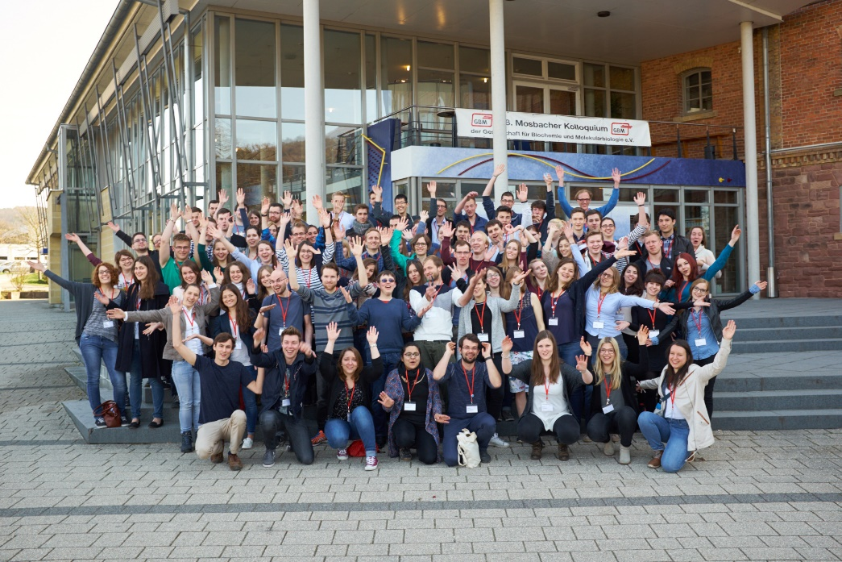
Junior-GBM
Young members organize their own local events, e.g. on training and career issues
Grants from the GBM
From first year students to PhD students and young Postdocs
Requirement: at least 5 junior members at one location (at least 3 for the first year)
Junior-GBM exists in Bielefeld, Bochum, Bonn, Darmstadt, Frankfurt, Freiburg, Greifswald, Halle, Hamburg, Hannover, Heidelberg, Jena, Kaiserslautern, Kassel, Kiel, Lübeck, Marburg, Munich, Münster, Tübingen...
...and maybe soon in your city?

Slide 6

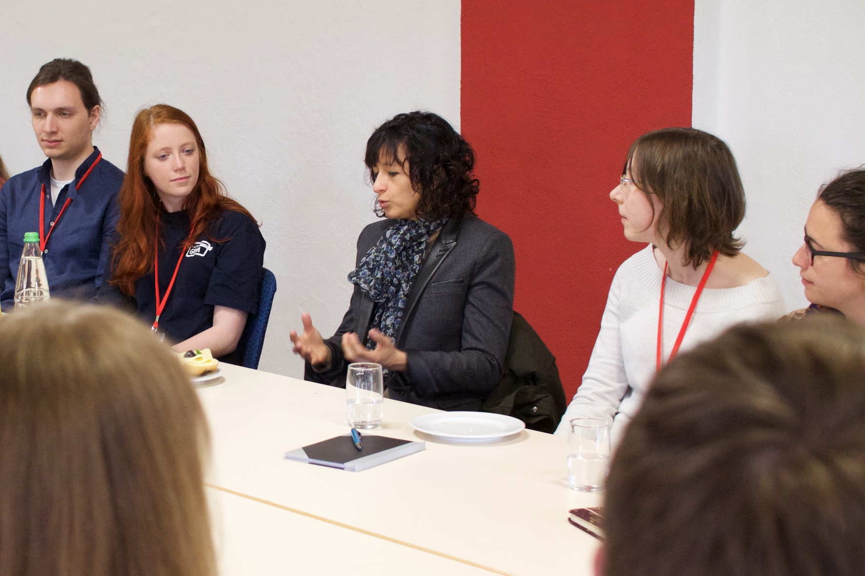
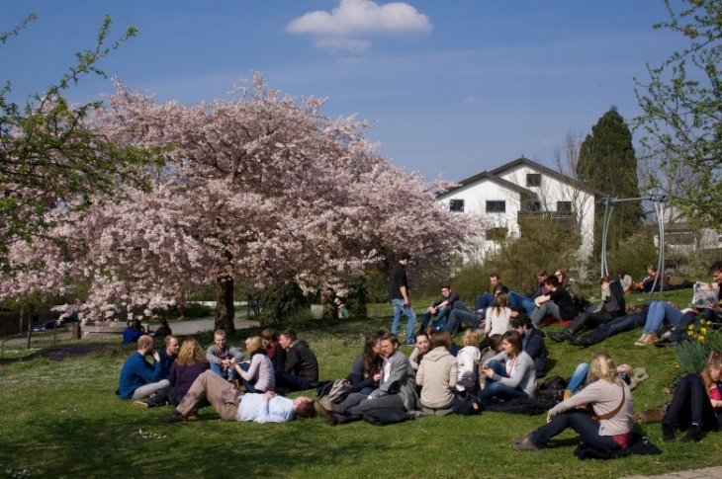
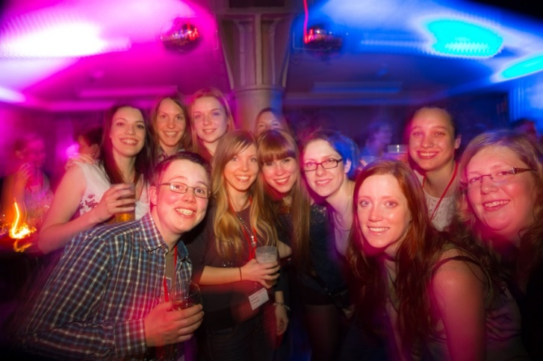
Junior GBM - Impressionen
Junior-GBM
General Assembly of the Junior GBM 2017 in Mosbach
„Meet the Prof“ with Emmanuelle Charpentier
Networking
Party in Mosbach

Slide 7

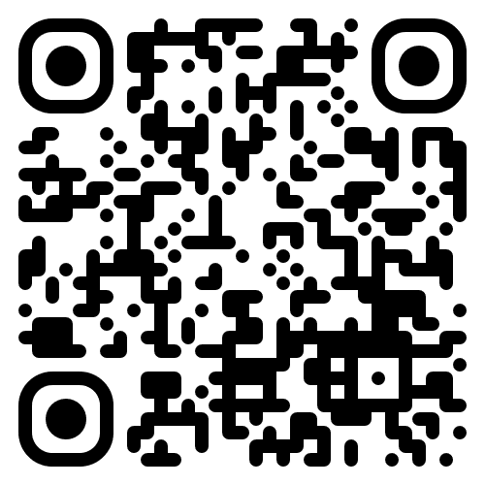
Postdocs @ GBM - Join our network
Get access to our 19 Study Groups, Young Investigators, Mentoring, Journals, Institutes, Industry and much more
Get connected! Become a member!
More information and contact:
https://gbm-online.de/nachwuchs/postdocs.html

Slide 8
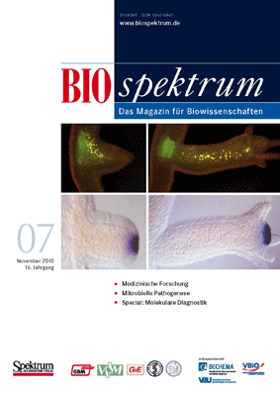

BIOspektrum: The association magazine
Specialist medium of the year 2009

Slide 9
The Study Groups of the GBM
Autophagy
Bioanalytics
Biochemical Pharmacology
and Toxicology
Bioenergetics
Bioinformatics
Biomembranes
Biophysical Chemistry
Chemical Biology
Glycobiology
Molecular Biology and
Biochemistry of Plants
Molecular Medicine
Molecular Cell Biology
Molecular Neurobiology
Redox Biology
Receptors and Signal
Transduction
RNA Biochemistry
Structural Biology
Synthetic Biology

Slide 10
GBM Working Groups (AK‘s)
AK Studies of Molecular Biosciences
Meeting of university teachers of biochemistry, molecular medicine, biomedicine, human biology, molecular biology and biotechnology.
AK Biochemistry in Medicine
Meeting of biochemistry professors of medical courses
AK History of Biochemistry
Founded in 2013. Aims to make the development of modern life sciences comprehensible.
AK Young Investigators
Exchange of experience, networking, representation of interests for young researchers
AK Senior Experts
Founded in 2018. Networking with the scientific interest of retired biochemists, forming a retrievable network of experts.
AK Industry
Founded in 2019. Represents the interests of GBM members from industry and networks industry and academia.

Slide 11
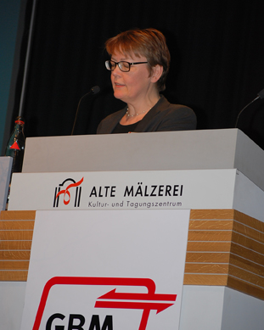
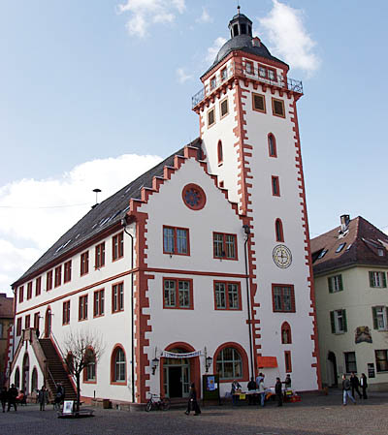
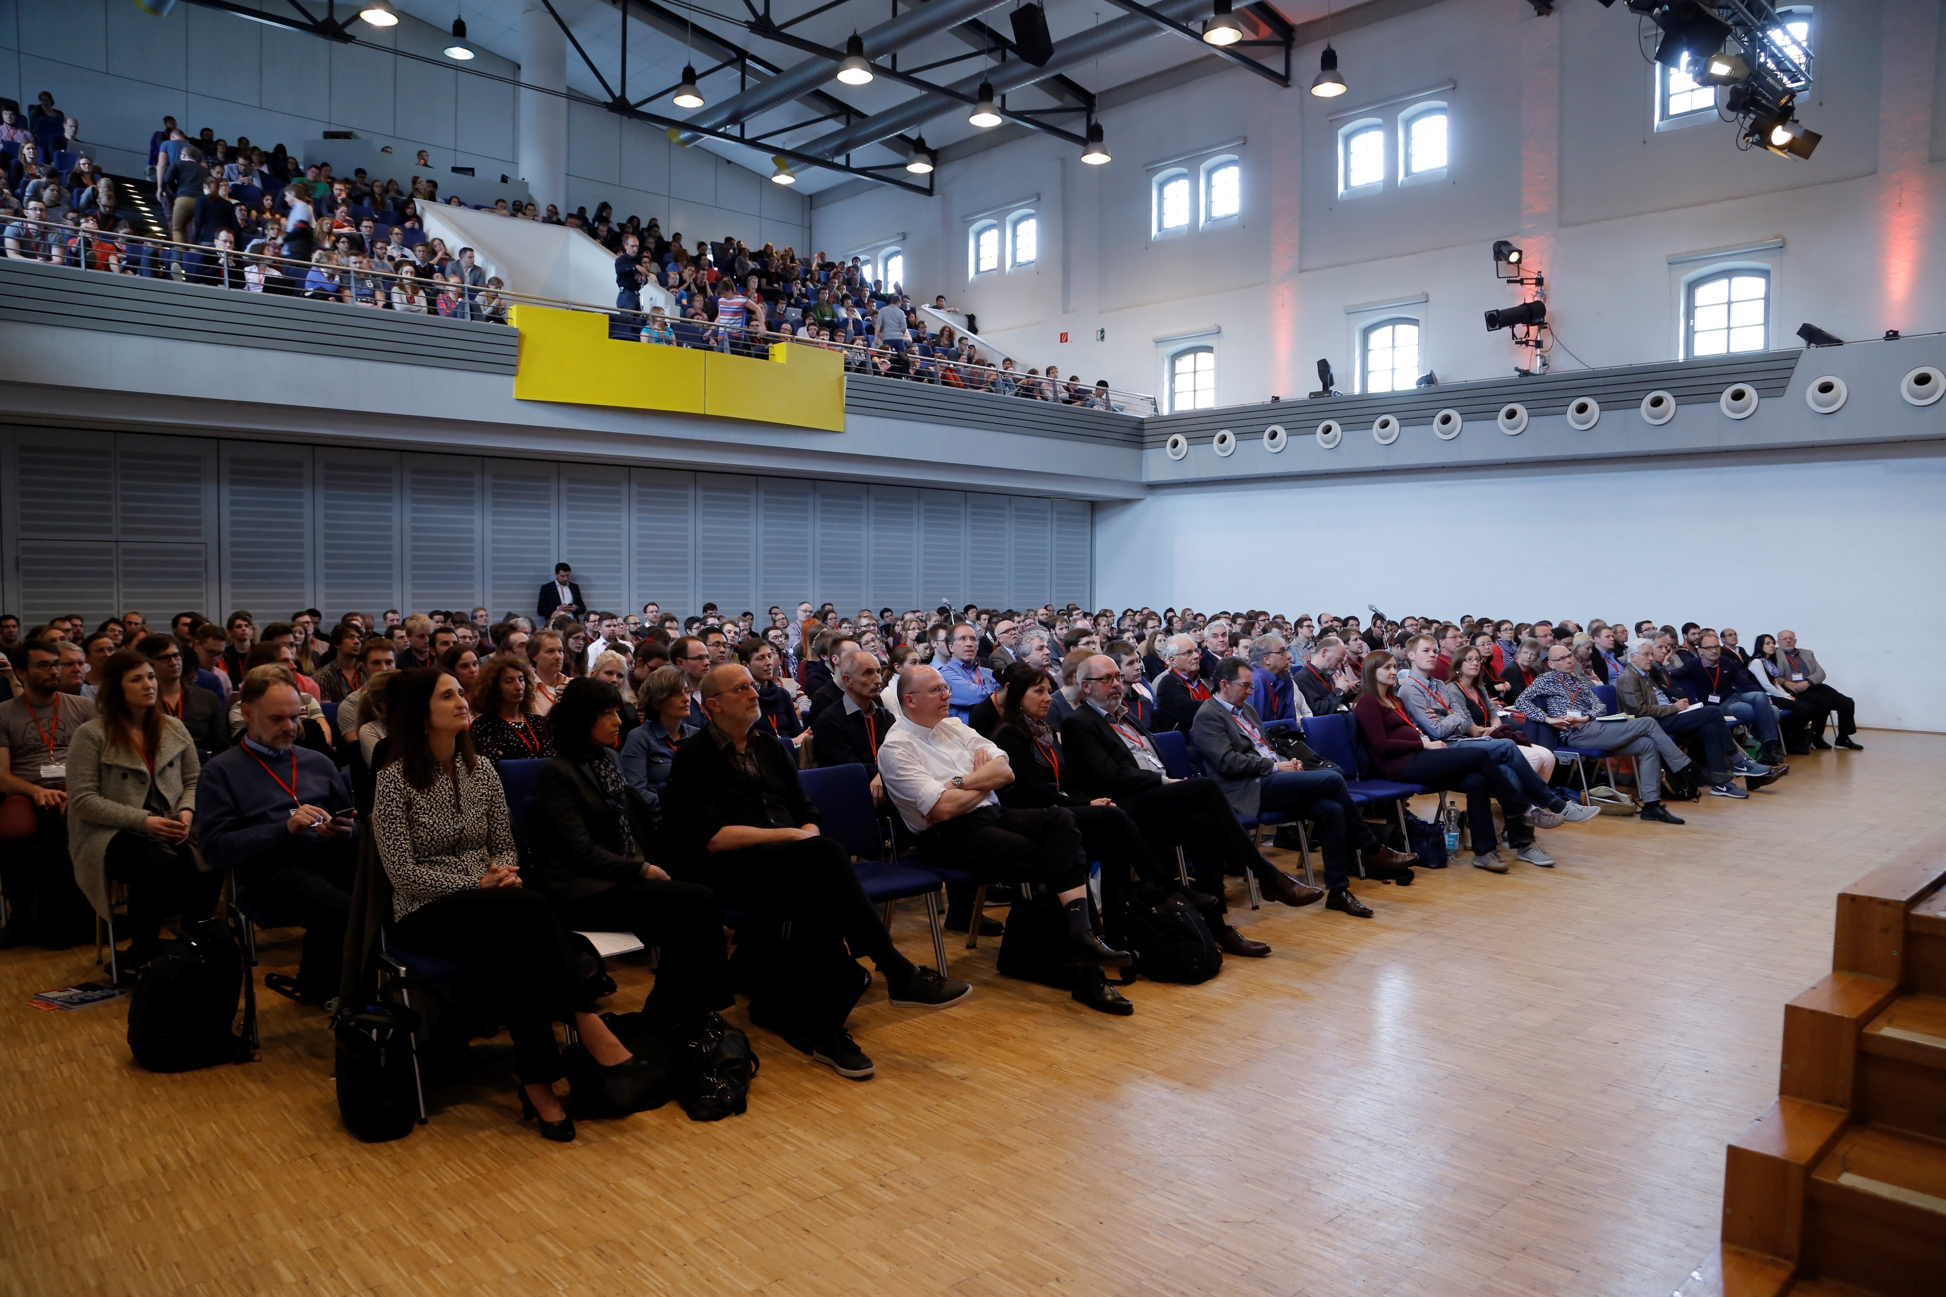
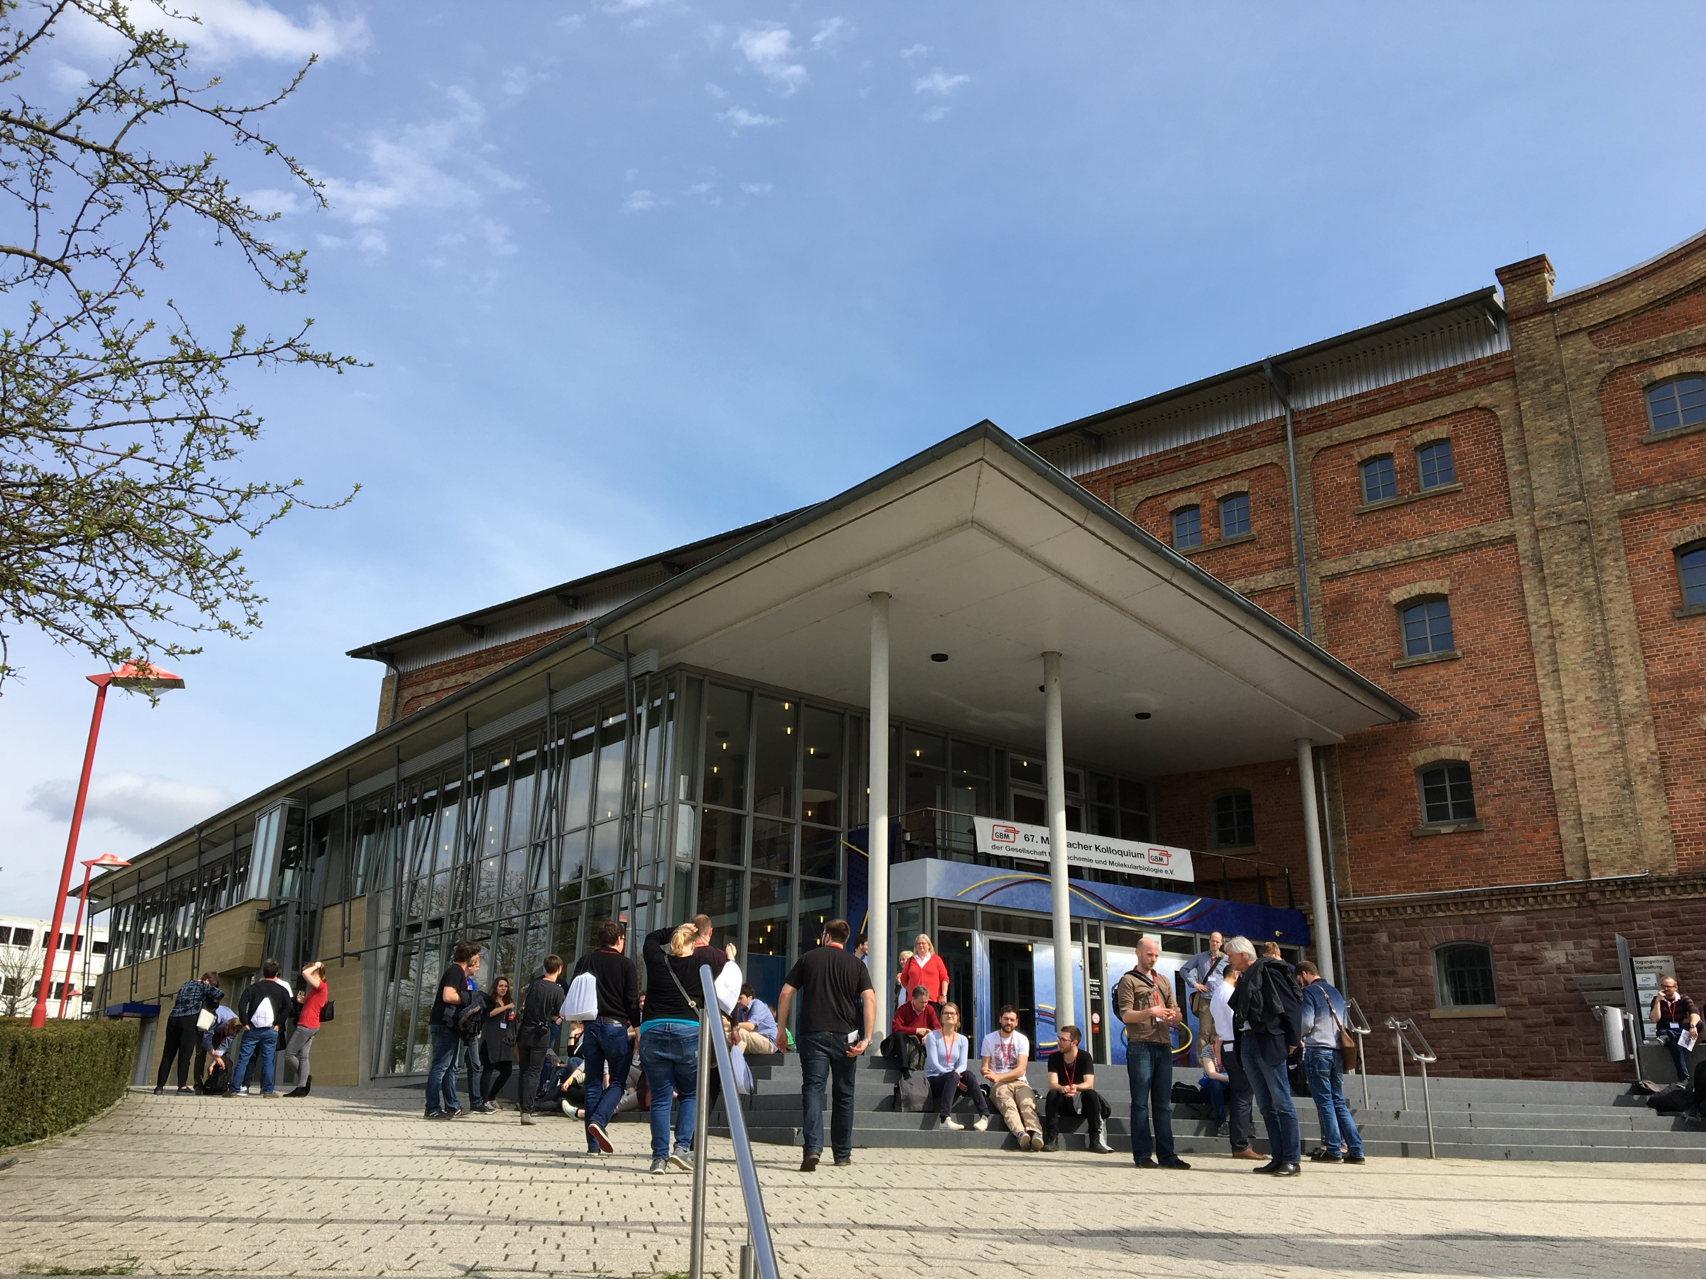
Mosbacher Kolloquium
The spring conference, the Mosbacher Kolloquium, provides a comprehensive overview of an annually changing topic.

Slide 12
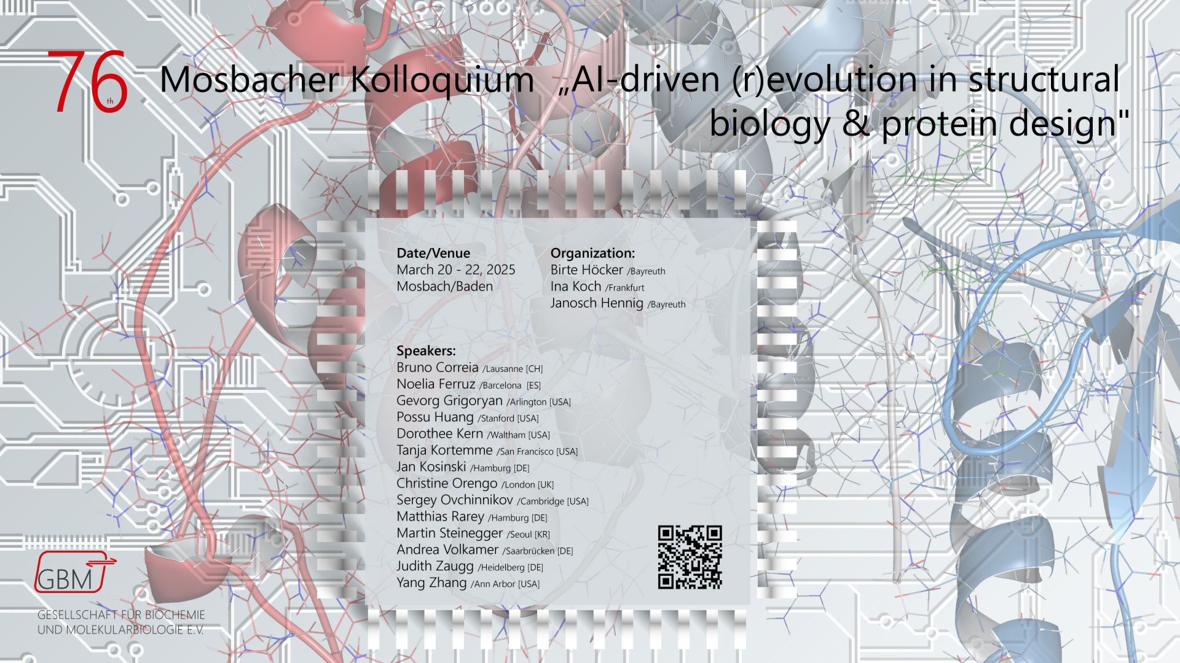
Save the date !

Slide 13
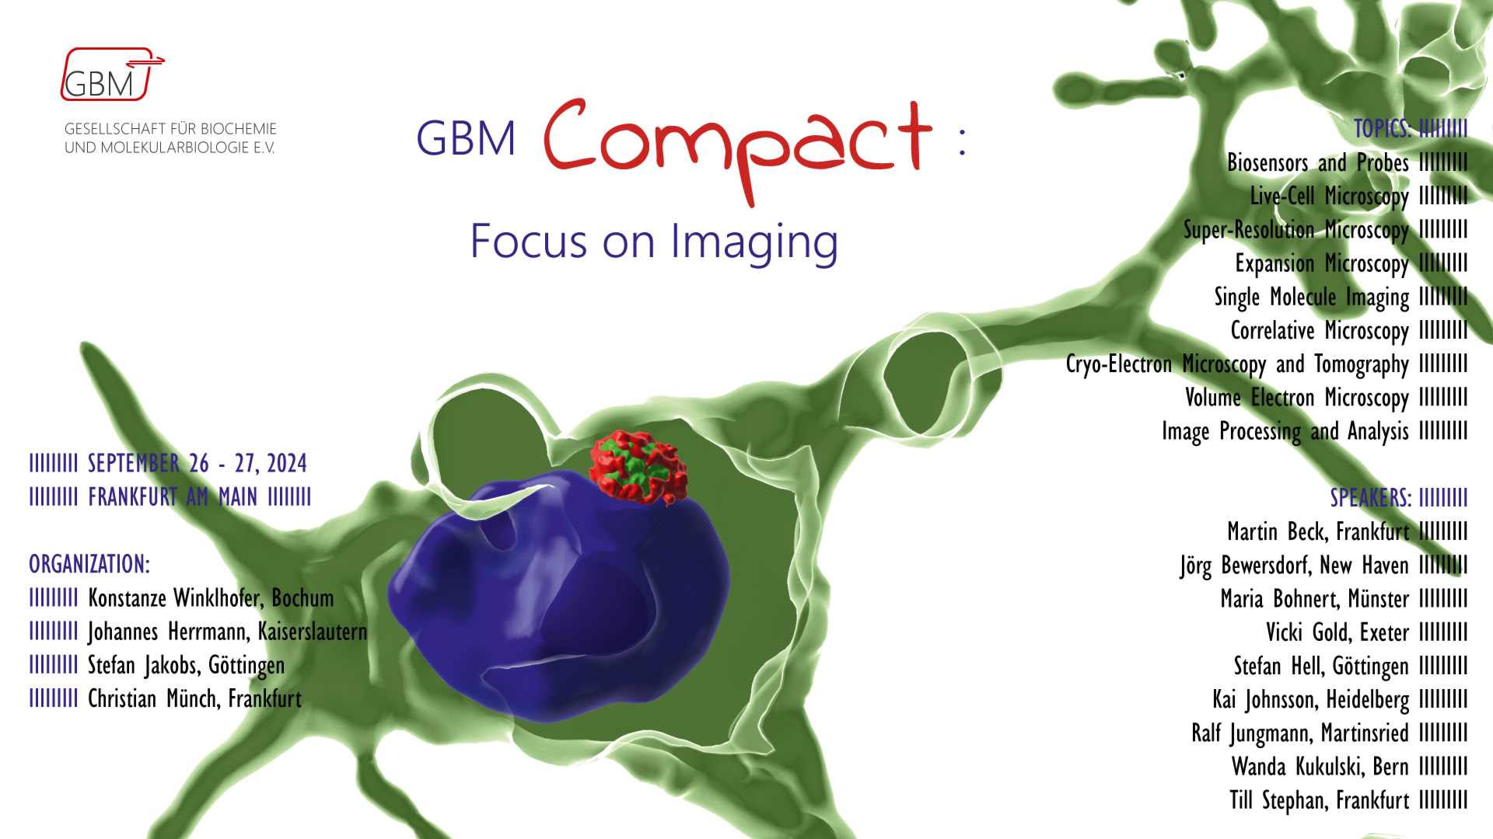
Save the date !

Slide 14


Joint conferences with the
BioPharma Cluster South Germany
Save the Date
Third joint conference on November 29th 2024, at Stadthaus Ulm:
Virus based therapies

Slide 15

Unsere nächsten Tagungen
Biweekly virtual lecture series organized by the study groups, the GBM Young Investigators, the Junior GBM and the working group Industry
Every second Wednesday,
12:30 – 13:30 (CEST)

Slide 16
GBM Office
Mörfelder Landstr. 125
60598 Frankfurt a.M.
Tel. +49/69/66 05 67- 0
Fax. +49/69/66 05 67- 22
info@gbm-online.de
www.gbm-online.de

